Slide 1
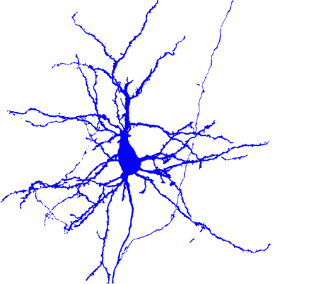
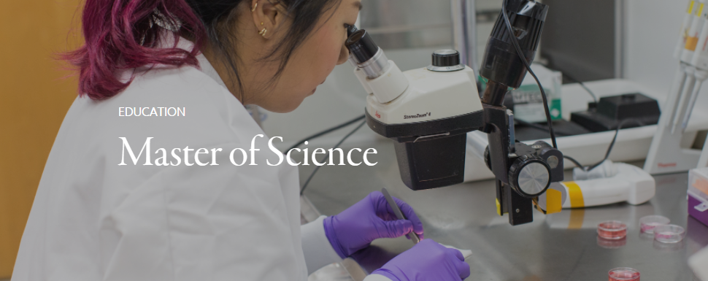
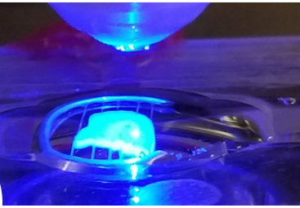
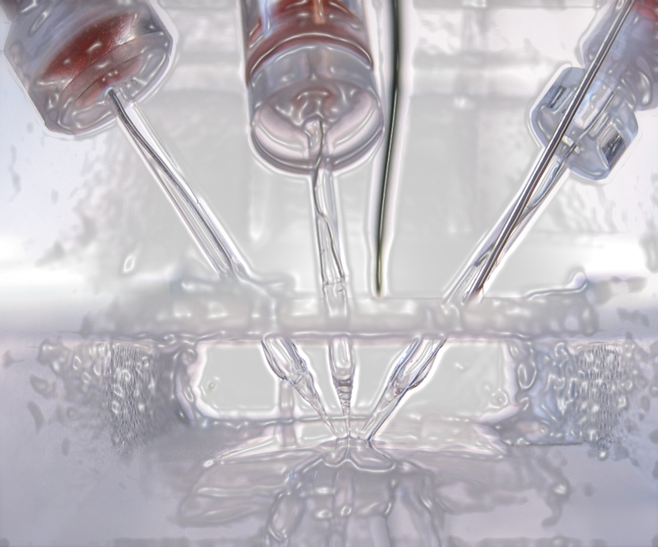
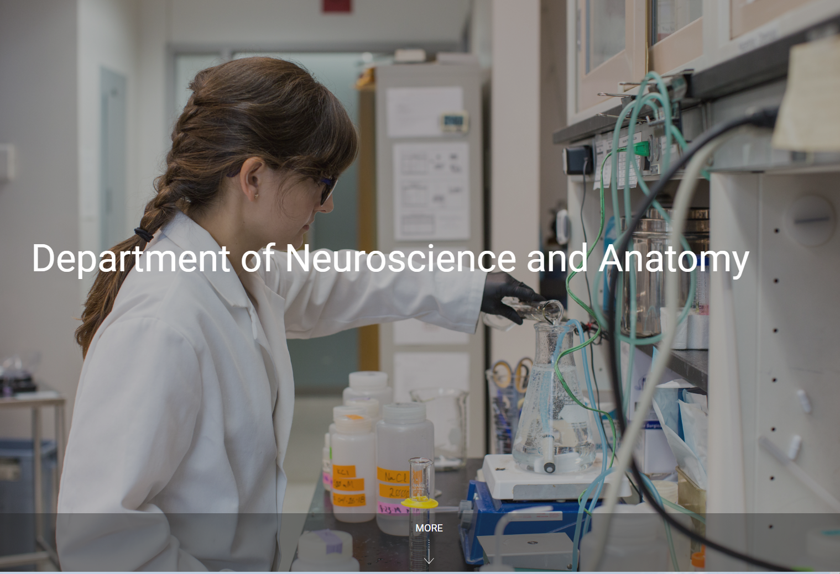
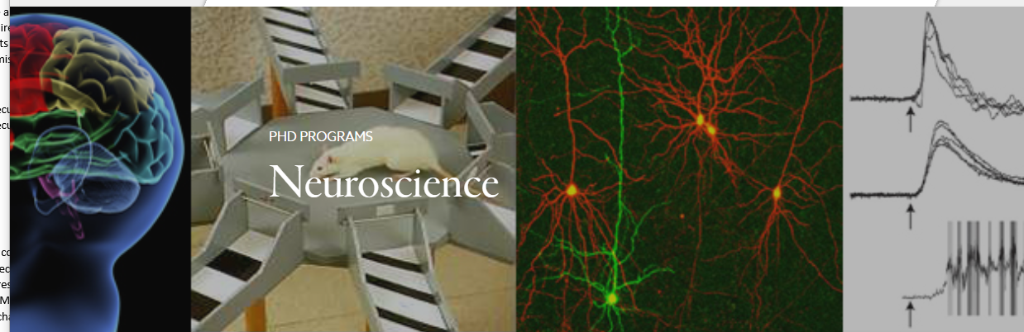
The Department of Neuroscience and Anatomy Faculty, Students and Staff
Welcome You
VCU MS-ANB Orientation

Slide 2
Anatomy and Neurobiology Master’s Program
Director of the Masters Program in Anatomy & Neurobiology (MS-ANB):
Kimberle M. Jacobs
Kimberle.Jacobs@vcuhealth.org
Cell phone: 804 387-0140
Office (if you don’t get an answer then call cell): 804 827-2135
Office location: Sanger Hall 12th floor, 12-042A
Turn left out of the elevators and follow corridor down and around the corner.
If important or urgent, please call my cell phone, otherwise, please email.

Slide 3
Go to Graduate Student On-Boarding on the Student Resources web page:
Student Resources - VCU School of Medicine
https://medschool.vcu.edu/education/graduate/current-students/
Please do check list!

Slide 4
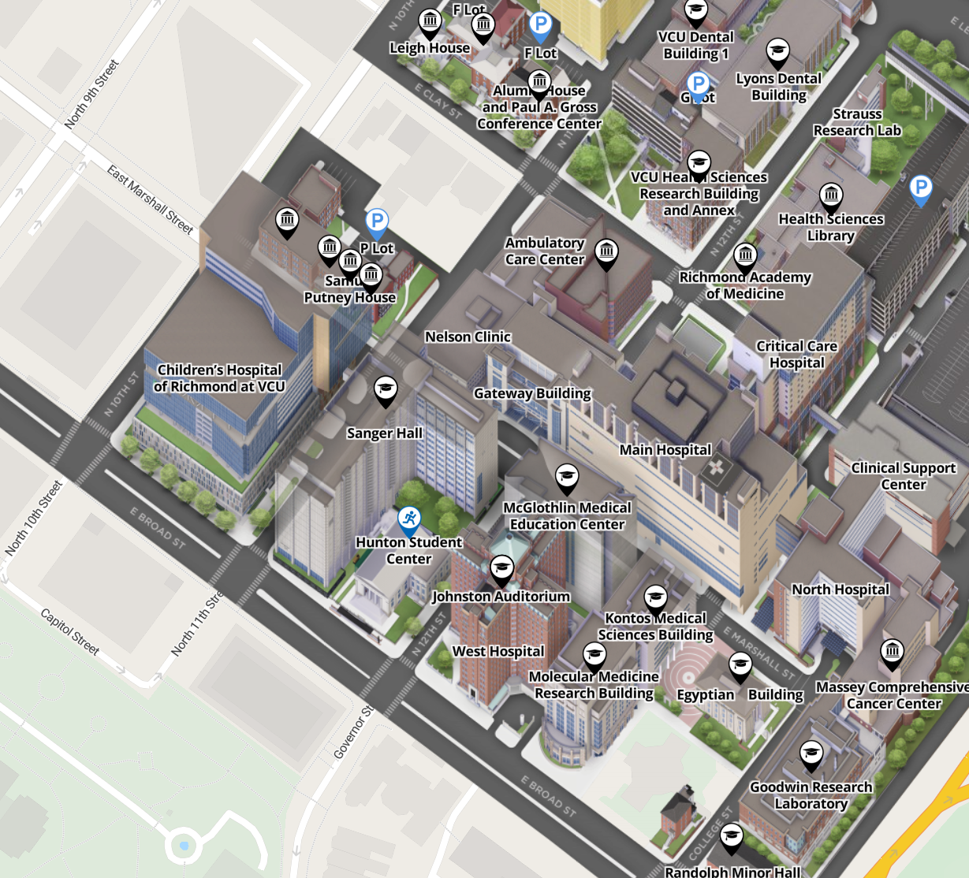
Most Classes will be in Sanger Hall or in the Molecular Medicine Research Building
Student ID Card and Student Health located at the VMI Building
VMI

Slide 5
Name Change! Our department is now called the Department of Neuroscience and Anatomy
However the program is still called the Masters in Anatomy & Neurobiology (MS-ANB)
2 Paths:
Thesis required
2 semesters in year 1 that focus on coursework.
Summer and second year that focus on research
Non-thesis concentration that focuses on training students to be Anatomy & Neurobiology Educators
Research Concentration
Anatomical Science Concentration

Slide 6
Research Concentration Required Courses
**Note if you graduated from VCU certificate program we will transfer credits to meet the course requirements
Year 1 Fall semester:
Biochemistry, Cell and Molecular Biology (BIOC 503) 5 credits
Cellular and Molecular Neuroscience (NEUS 609) 4 credits
Faculty Research Seminar (ANAT 690) 1 credit
A total of 37 credits are required:
24 course credits
13 directed research credits
Year 1 Spring semester:
Biochemistry, Cell and Molecular Biology (BIOC 504) 5 credits
Systems Neuroscience (ANAT 610) 4 credits
Faculty Research Seminar (ANAT 690) 1 credit
Directed Research (ANAT 697) 1 credit
Masters web site:
anatomy.vcu.edu/education/master-of-science/
Year 1 SUMMER semester:
Directed Research (ANAT 697) 1 credit
Modify the number of research credits: Variable credit courses - Office of the University Registrar - Virginia Commonwealth University
Year 2 Fall semester:
Scientific Integrity (OVPR 601) 1 credit
Laboratory Safety (IBMS 600) 1 credit
Faculty Research Seminar (ANAT 690) 1 credit
Directed Research (ANAT697) 5 credits
Year 2 Spring semester:
Faculty Research Seminar (ANAT 690) 1 credit
Directed Research (ANAT 697) 6 credits

Slide 7
New Concentration in Anatomical Sciences Education
Fall – yr1
Cellular and Molecular Neuroscience Neus609 (4 credits)
Biochemistry, Cell and Molecular Biology Bioc503 (5 credits)
Faculty Research Seminar Anat690 (1 credit)
Spring – yr1
Systems Neuroscience Anat610 (4 credits)
Scientific Integrity Ovpr601 (1 credit)
ADLT670, 671 or 672 (3 credits)
Faculty Research Seminar Anat690 (1 credit)
Laboratory Safety Ibms600 (1 credit)
Fall – yr2
Histology Anat611 (5 credits)
Human Gross Anatomy (3 credits)
Faculty Research Seminar Anat690 (1 credit)
ADLT670, 671 or 672 (3 credits)
Spring – yr2
Embryology Anat612 (2 credits) or elective
ADLT670, 671 or 672 (3 credits)
Faculty Research Seminar Anat690 (1 credit)
Capstone project (2 credits)
ADLT670 Curriculum Design in Health Professions Education
ADLT671 Theory and Practice of Adult Learning for Health Professions Educators
ADLT672 Instructional strategies for Teaching in Health Professions
Notes:
Gross in beginning
Then could TA in 2nd year
Embryo is in Fall
Course number for TAing? 697 or 613

Slide 8
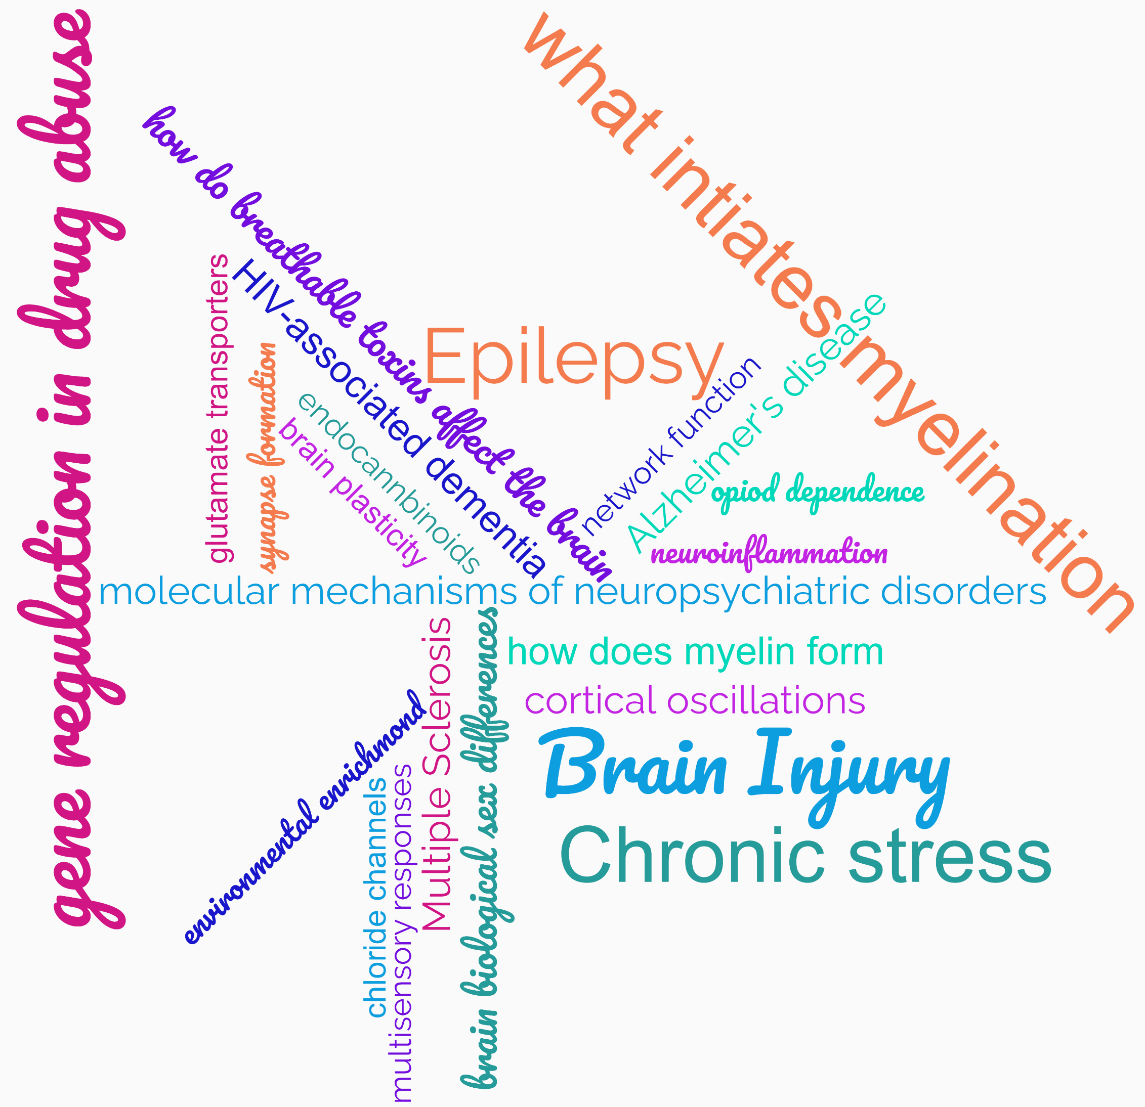
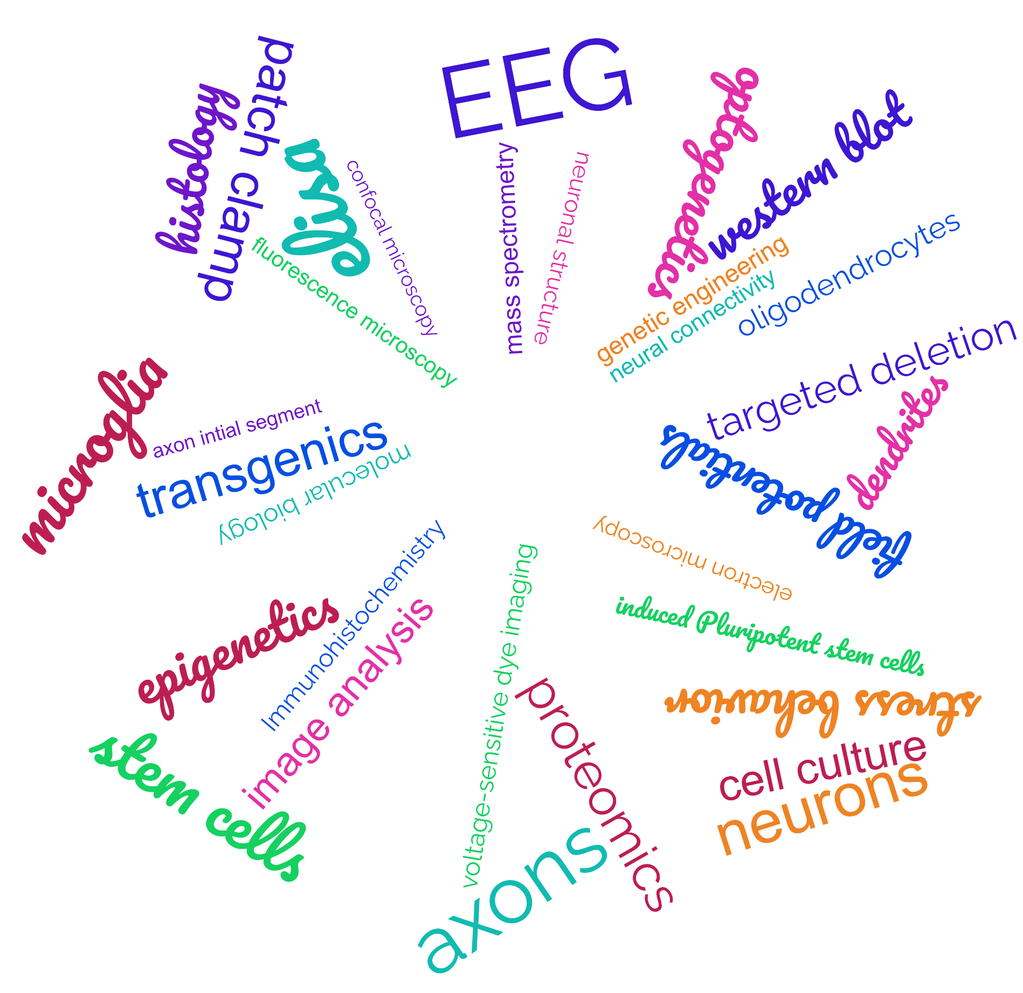
Master of Science in Anatomy and Neurobiology Research topics – word cloud
Program Director: Kimberle M. Jacobs, PhD Kimberle.Jacobs@vcuhealth.org 804 387-0140

Slide 9
Master of Science in Anatomy and Neurobiology
Explore the research: anatomy.vcu.edu/research-groups/
Previous Masters Theses in the Department of Anatomy & Neurobiology
The Effect of Mild Traumatic Brain Injury on Perineuronal Nets Surrounding Neocortical Parvalbumin Interneurons – Olivia Lowman, Jacobs and Greer labs
Quantitative Changes in Hippocampal CCR5+ Microglia and Neurons with the Administration of Maraviroc (MVC): Does Sex Matter? – Ama Boakye-Agyei, Knapp lab
Exosomes as systemic mediators of nanotube induced neurotoxicty – Christopher Canal, Ottens lab
The role of GLT-1 signaling in oligodendrocytes during development and myelin repair – Elizabeth Thomason, Fuss lab
Interneuron subtypes are differentially altered in malformed, epileptogenic cortex – Amanda George, Jacobs lab
Behavioral and quantitative electroencephalogram alterations during the whisker nuisance task following mild traumatic brain injury in mice - David Wildman, Greer lab
Potential treatments for malformation associated epilepsy – Olivia Bowles, Jacobs lab
A study on the mechanism of CLP290 restoration of KCC2 and Neuroprotection after traumatic brain injury – Ekaterina Stepanova, Ottens lab
Effects of gestational ozone exposure on privileged placental and brain barrier integrity – Alexander Hamm, Ottens lab
Effects of Buprenorphine treatment on myelin following traumatic brain injury in a rat model – Jane Ryu, Lafrenaye lab
Modulation in NMDA receptor function alleviates safety learning deficit in females who experienced chronic stress during adolescence – Zuby Okafor, Neigh lab
Program Director: Kimberle M. Jacobs, PhD Kimberle.Jacobs@vcuhealth.org 804 827-2135

Slide 10
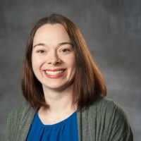
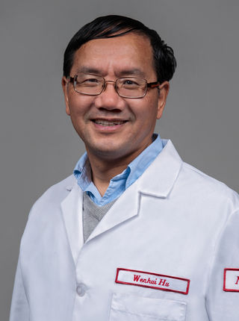
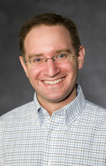
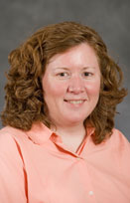
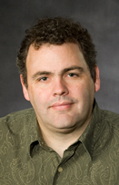
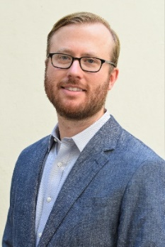
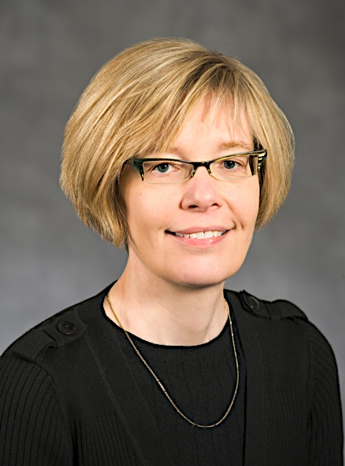
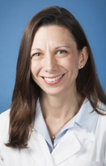
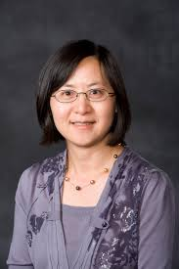
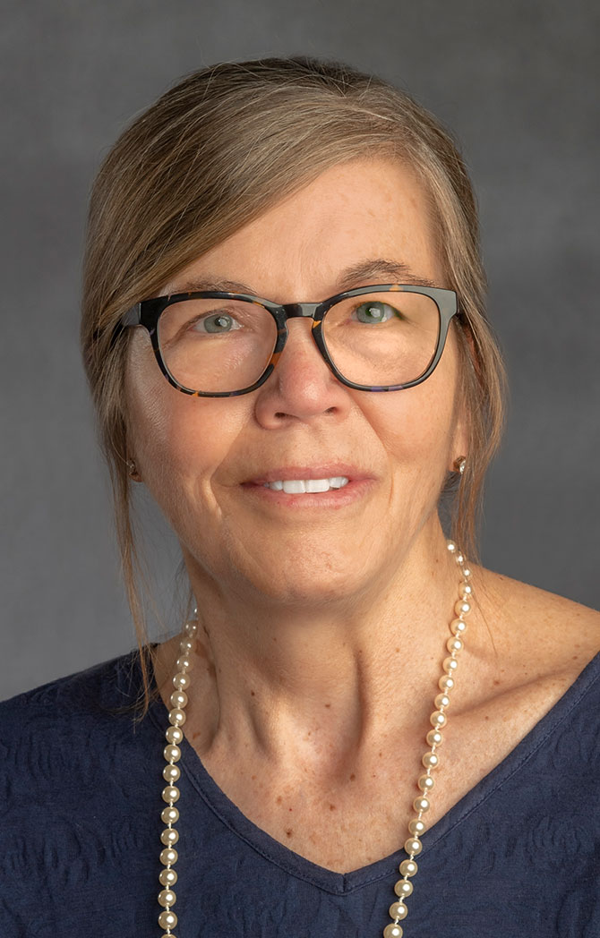
Possible Research Mentors
Audrey Lafrenaye glial and neuronal pathologies traumatic brain injury, in vivo models, behavioral, microscopic and molecular assessments
audrey.lafrenaye@vcuhealth.org
Wenhui Hu HIV, gene regulation, signal transduction, G protein signaling, novel biotechnology Wenhui.hu@vcuhealth.org
Andy Ottens toxicological exposures and traumatic insults to the brain, mass spectrometry, bioactive peptides, proteolytic degradation andrew.ottens@vcuhealth.org
https://ottenslab.weebly.com/
*
Kimberle Jacobs developmental epilepsy, traumatic brain injury, cellular and network neurophysiology, optogenetics, EEG, microscopy, immunohistochemistry, structure
Kimberle.jacobs@vcuhealth.org
www.kmjacobslab.org
Rory McQuiston Alzheimer’s, memory formation, brain rhythms, neuromodulators, neurophysiology, voltage-sensitive dyes, optogenetics, transgenics, immunohistochemistry adam.mcquiston@vcuhealth.org
Peter Hamilton molecular mechanisms in neuropsychiatric syndromes, engineer epigenetic editing tool, pharmacotherapies, behavior
peter.hamilton@vcuhealth.org
*
Babette Fuss multiple sclerosis, myelination, neuropsychiatric disorders, autotaxin-lysophospholipid signaling, glutamate transporter signaling, tissue culture, transgenics babette.fuss@vcuhealth.org
*
Gretchen Neigh Stress during adolescence, endocrine-immune interactions, behavior, histology, microscopy, cell culture, molecular biology gretchen.mccandless@vcuhealth.org
https://www.gretchenneigh.com/
Dong Sun molecular mechanisms neural repair and regeneration, brain injury, Alzheimer’s, neural stem cell cultures, immunohistochemistry, western blottin, behavior, microscopy dong.sun@vcuhealth.org
*
Pam Knapp HIV-associated dementia, neuron-glia interactions, opiate signaling, tissue culture, immunohistochemistry, confocal and electron microscopy, in situ hybridization, PCR, biochemistry pamela.knapp@vcuhealth.org

Slide 11
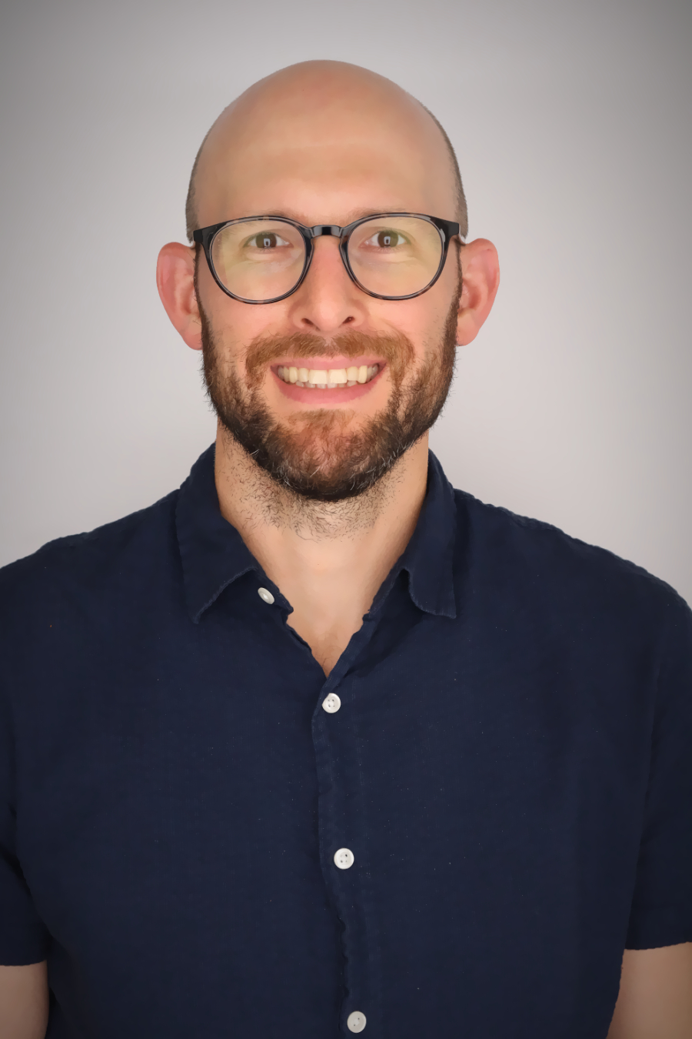
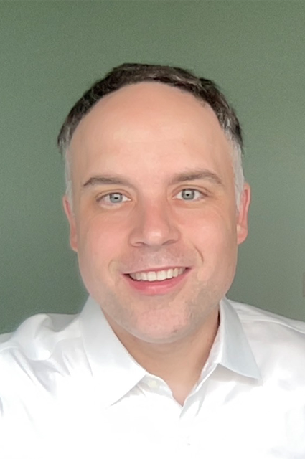
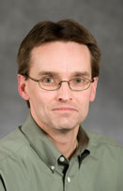
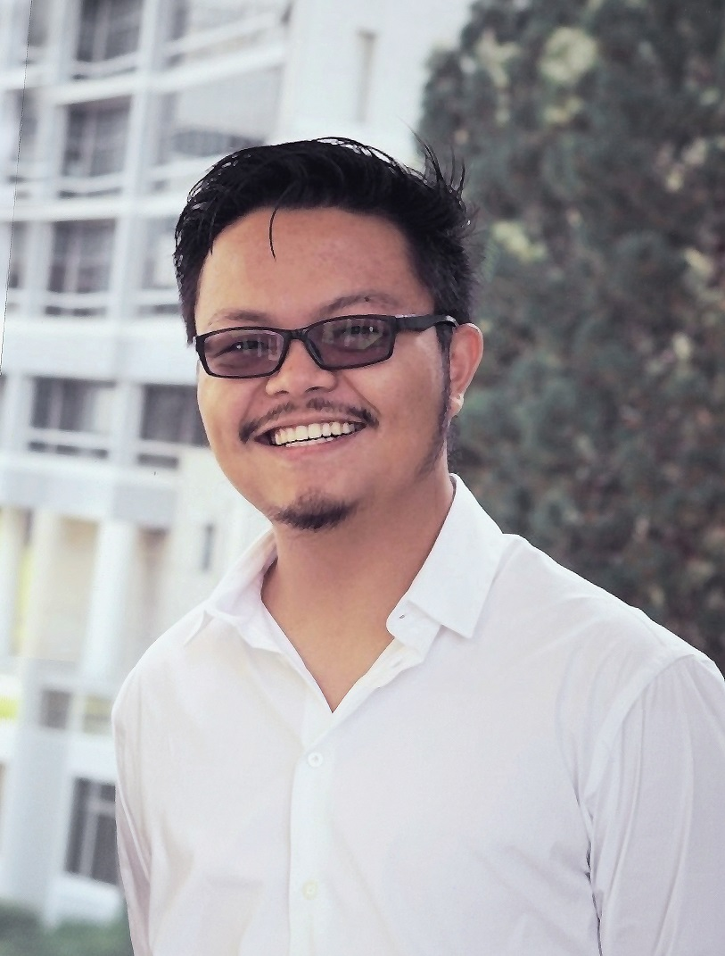
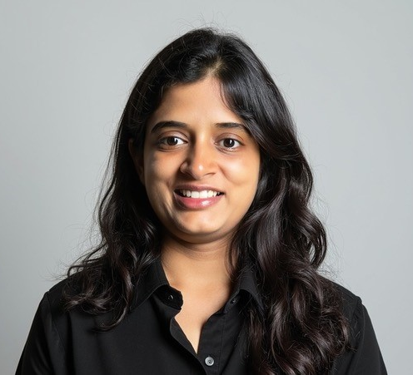
Continued Faculty Expertise
Aaron Barbour
New faculty member with expertise in epilepsy, Alzhiemer’s, Gaba signaling
aaron.barbour@vcuhealth.org
Andrew Crowther
New faculty member with expertise in pain and itch,cerebellum andrew.crowther@vcuhealth.org
Jeff Dupree multiple sclerosis, axon structure, axon initial segment, microglia, immunohistochemistry, western blots, microscopy jeffery.dupree@vcuhealth.org
*
Guangwei Zhang
New faculty member
Guangwei.Zhang@vcuhealth.org
Seetha Krishnan
New faculty member with expertisereward systems, hippocampus, virtual reality for rodents
Seetha.krishnan@vcuhealth.org

Slide 12
Dong Sun Projects
Guang-Wei Area of research
primarily focused on the social impairments in neuropsychiatric disorders, using AI-based behavioral analysis, and high density recording aiming to develop treatment
Project #1: Developing a novel AAV gene delivery system to enhance an important synaptic protein expression in the brain and assess its therapeutic efficacy for Alzheimer’s Disease.
Project #2. Investigating the lung-brain axis following acute respiratory distress syndrome (ARDS) and mechanical ventilation (MV) in the Alzheimer’s Disease population with a particular focus on the role of
NLRP3 inflammasome in the brain-lung axis signaling.
Project #3. Exploring the connection of traumatic brain injury to the onset of Alzheimer’s disease with particular focus on the role of TBI triggered activation of NLRP3 inflammasome in mediating immune response in AD.
Project #4. Examining the functional contribution of adult neurogenesis in the hippocampus in hippocampal circuit reorganization following traumatic brain injury.

Slide 13
Get more information about individual faculty members via the faculty expertise directory.
See departmental link for faculty below, then click on individual faculty member.
Our Team - Department of Neuroscience and Anatomy - VCU School of Medicine:
https://anatomy.vcu.edu/about/our-team/
https://medschool.vcu.edu/about/portfolio/details/peknapp/

Slide 14
General timeline for thesis concentration
This is a research-oriented degree program comprised of graduate course work and supervised research leading to a written Master's thesis and oral defense of the thesis.
The Master of Science program involves one year of course work (if a grade of B or above is achieved for each required course). If you get a C – you must retake the course or an equivalent.
You should start lab rotations and become familiar with techniques needed in the Spring semester of your first year. Find the faculty member with your interests and email them to ask if they are taking on Masters students, and indicate that you would like to rotate in their lab.
The summer of the first year and the entire second academic year should focus on data collection and ultimately writing the thesis.
In many cases the research can be completed within the second year. There are two typical graduation dates, one in May and one in August.
Once you successfully defend and subsequently correct your thesis and all forms have been submitted, you can leave campus (you don’t need to stay until graduation).
There is no penalty to extend the work into a 3rd year (or more), however even when the necessary credits have been achieved, you need to pay for 1 credit per semester until you graduate.

Slide 15
Optimal Timeline to complete the research and thesis portion of the work
Best to have an advisor and some knowledge of techniques to be used by end of Spring semester of 1st year.
Summer of year 1: June – August – begin collecting data, determine if idea is feasible, read background literature, become independent in the methodologies necessary
Beginning of 2nd year: September – Establish thesis committee – requires advisor in the A&N dept, plus 1 more regular faculty member or affiliate of the A&N dept plus 1 outside faculty member. The outside can be any faculty of any other departments at VCU OR from another university (so a total of 3 faculty members). To setup the committee – the student goes to GradTrak and picks the members! There is a button to click if the faculty member you want to use has not previously been on a committee for SOM grad degrees.
Sept/Oct of 2nd year: Have 1st committee meeting. This establishes what the project will be. Typically a powerpoint is shown by the student to indicate student understand the problem, what hypothesis will be tested, and how that testing will occur, and often 1 figure is shown of preliminary data.
Sept – March or until work is done- work like crazy.
Feb/March – have 2nd committee meeting (optional) – but if you do this and show your figures – it will make your defense easier.
If you want to graduate in early May – you need to defend in April. If you want to graduate by early August – you can defend as late as late July or as early as early May. You can leave VCU when finalized version of thesis is turned in after a successful defense.

Slide 16
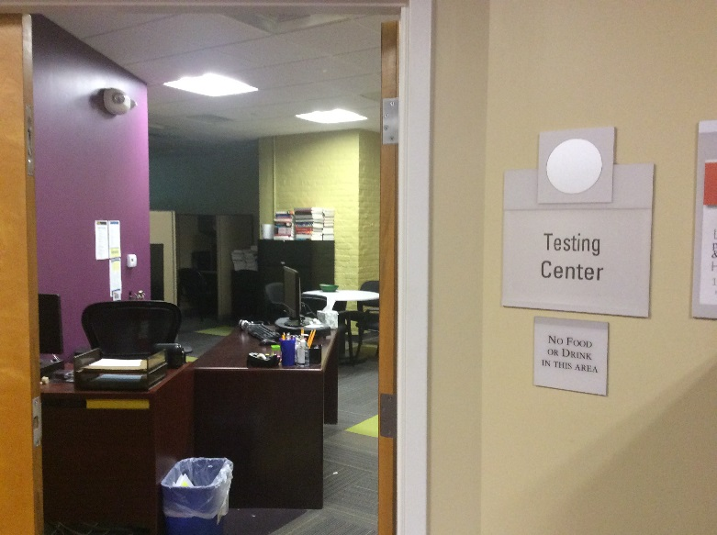
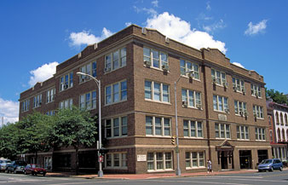
Academic Support Services
Division for Academic Success
VMI Building, 2nd Floor Suite. 231
(804) 827-2107
Andrew Anderson, M.S.
aanderson42@vcu.edu
http://www.das.vcu.edu/
Testing Center
Tutoring Services
Time Management Strategies
Study Strategies
Test Taking Skills
Note Taking Skills
Learning Connections Inventory©
Can provide tutors (free of charge) for all graduate level courses and help with developing new learning strategies.

Slide 17
Important web sites for current students
GradTrak – used to set up your committee AND schedule your defense
DegreeWorks – used to follow your academic coursework and credits
Before the Spring semester of the 2nd year – you should fill out the Degree Candidacy form (click here)
Dean’s list of helpful links for graduate students
Instructions on changing the number of directed research credits to more than 1

