Slide 1
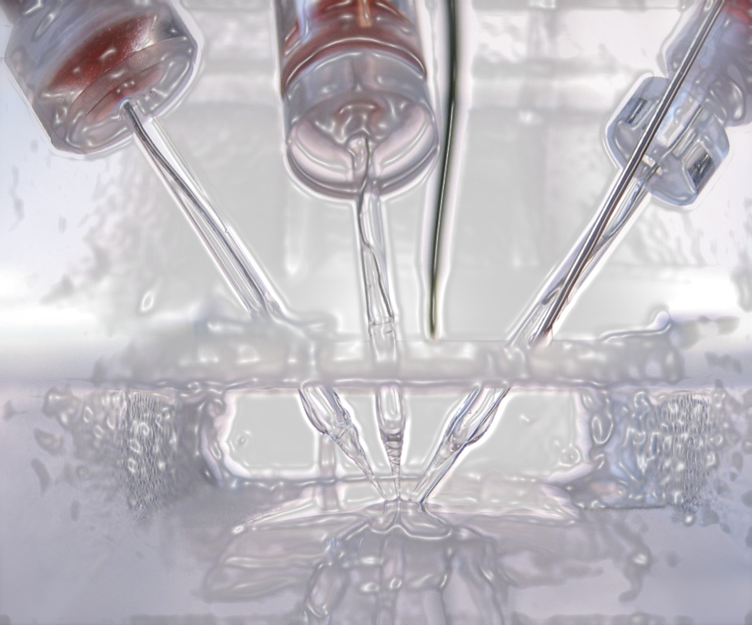
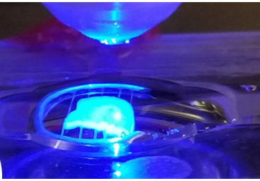
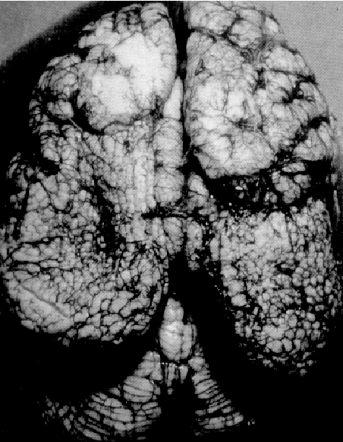
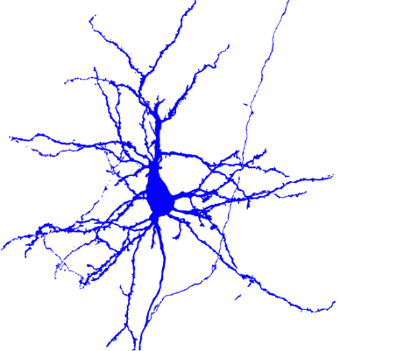
traumatic brain injury
Kimberle M. Jacobs, PhD Kimberle.Jacobs@vcuhealth.org www.kmjacobslab.org
Department of Neuroscience & Anatomy: https://anatomy.vcu.edu/research-groups/pdc/
Epilepsy
In collaboration with neurosurgeon John Greer, MD, PhD
What is the best mechanism-based treatment for children with cortical malformation-associated seizures ?
Why do patients have persistent cognitive difficulties, after mild brain injuries ?
Cellular & network approaches
Neuronal structure and function
Synaptic plasticity
Optogenetics
Whole cell patch clamp
Field potentials
EEG
Whisker nuisance task
Barkovich et al (1992) Am J Neurorad, 13: 423.

Slide 2
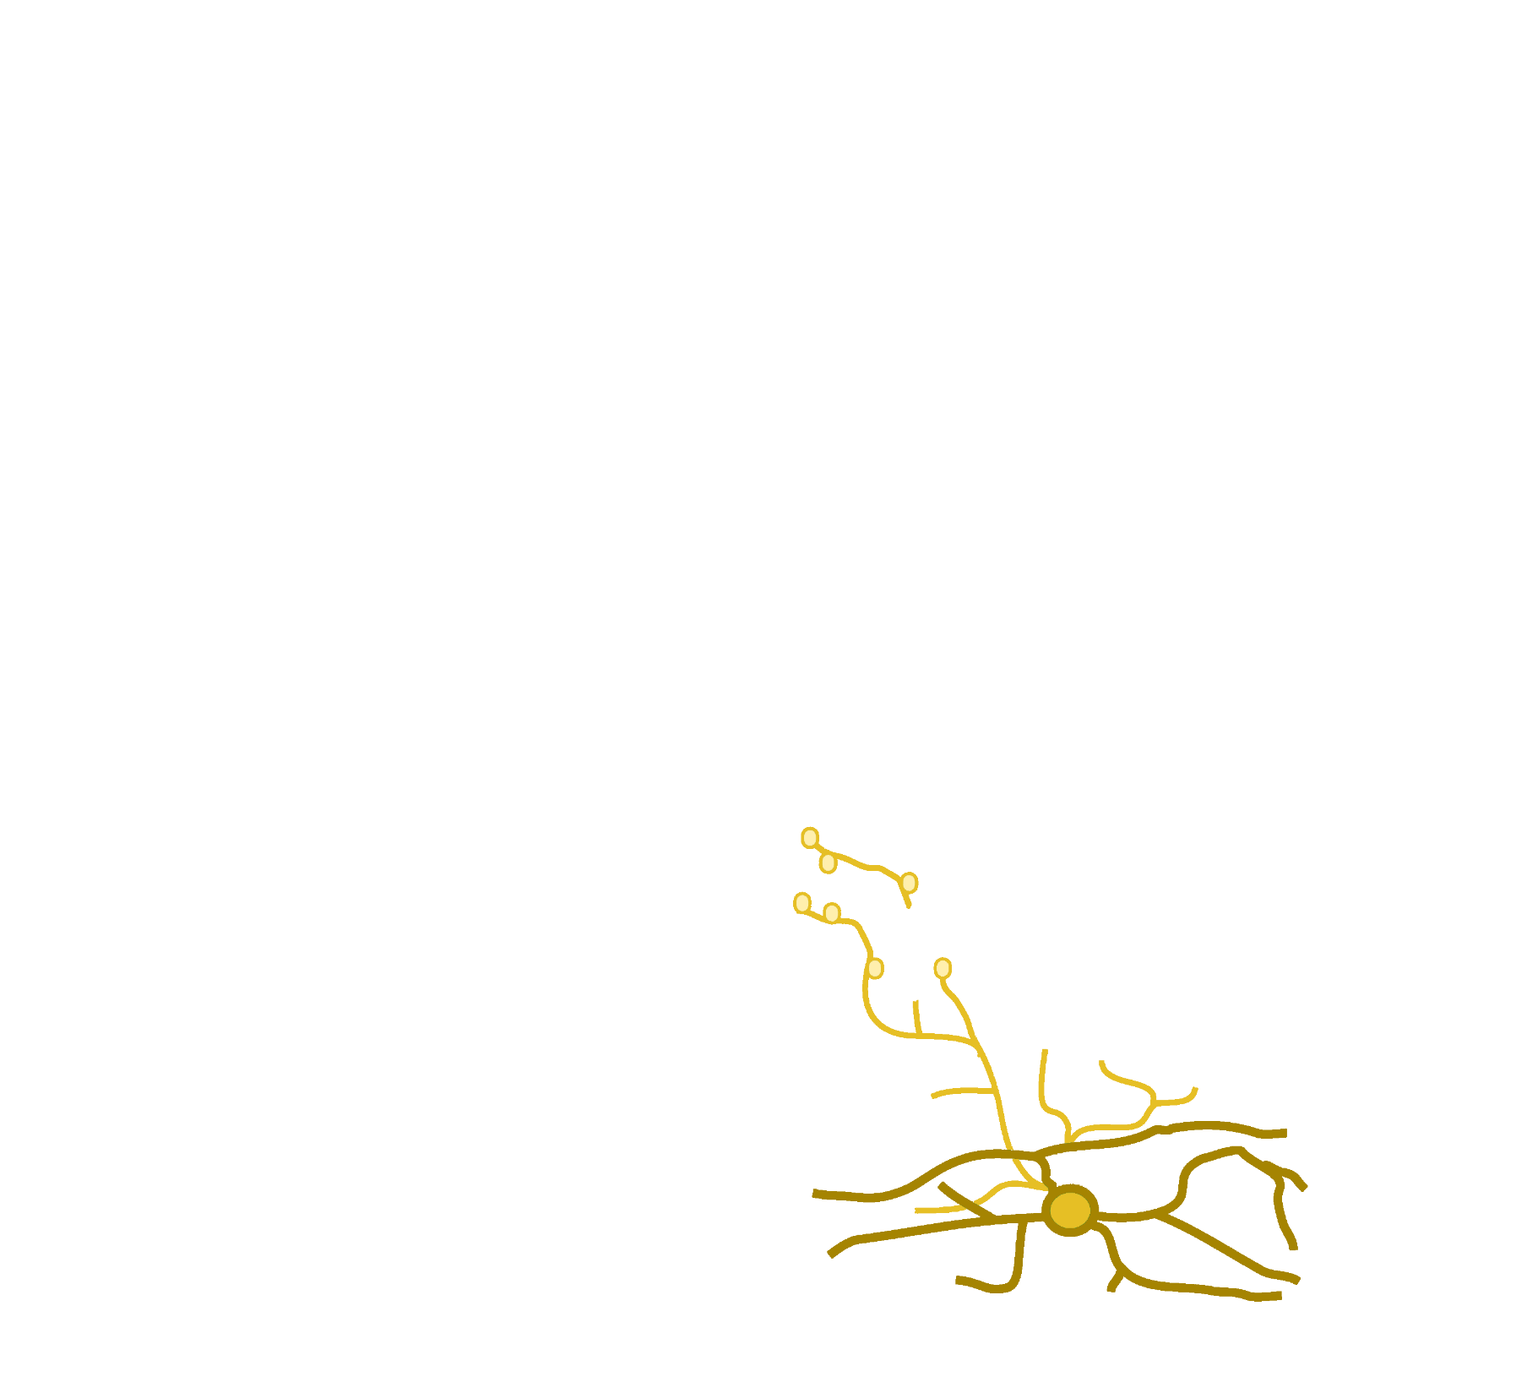
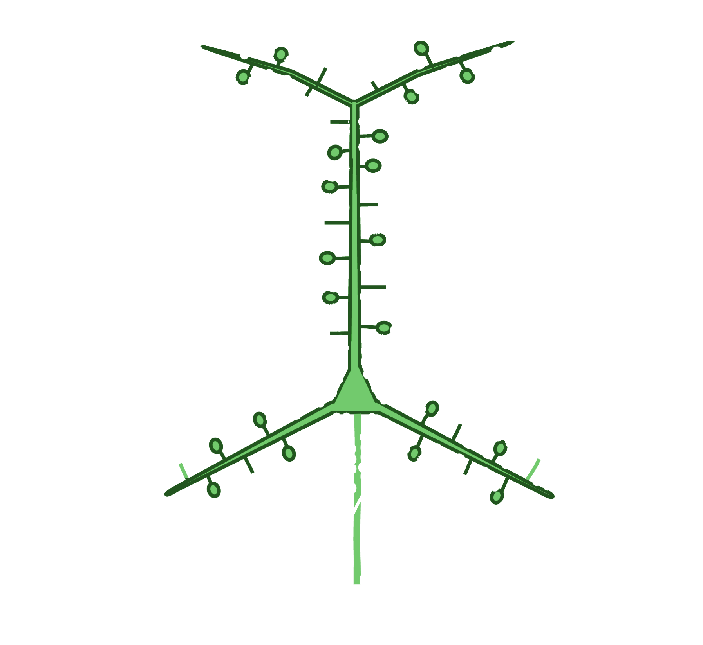
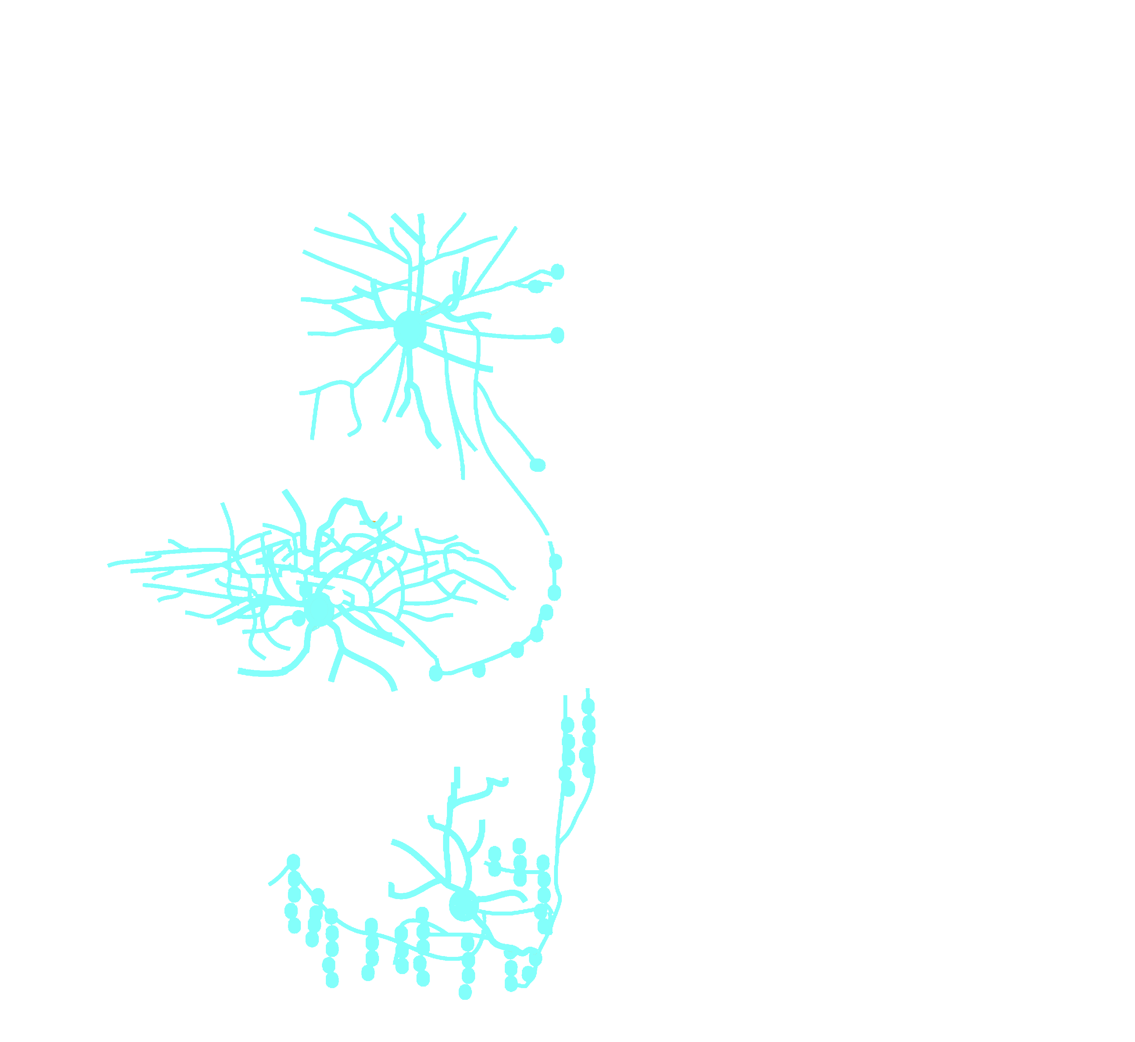
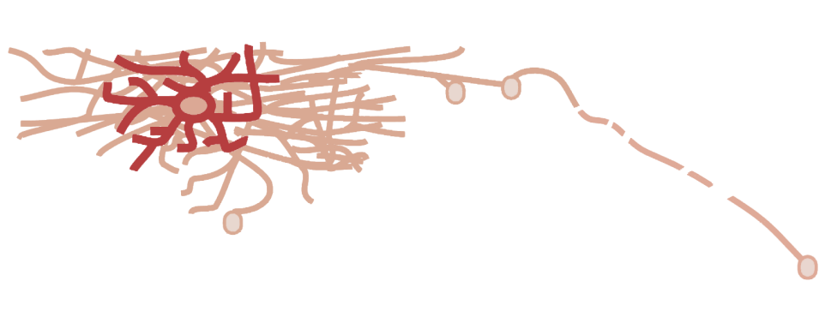
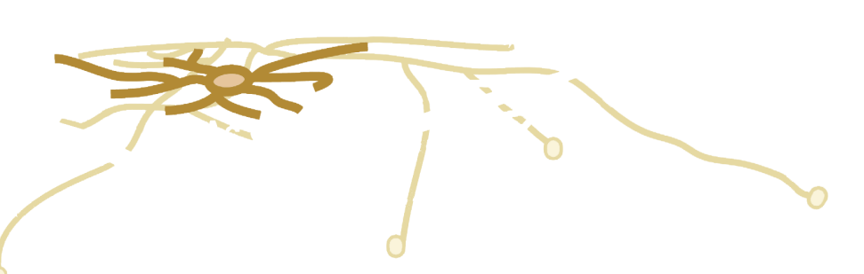
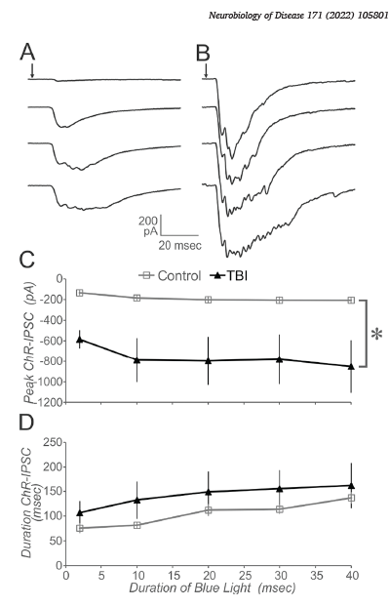
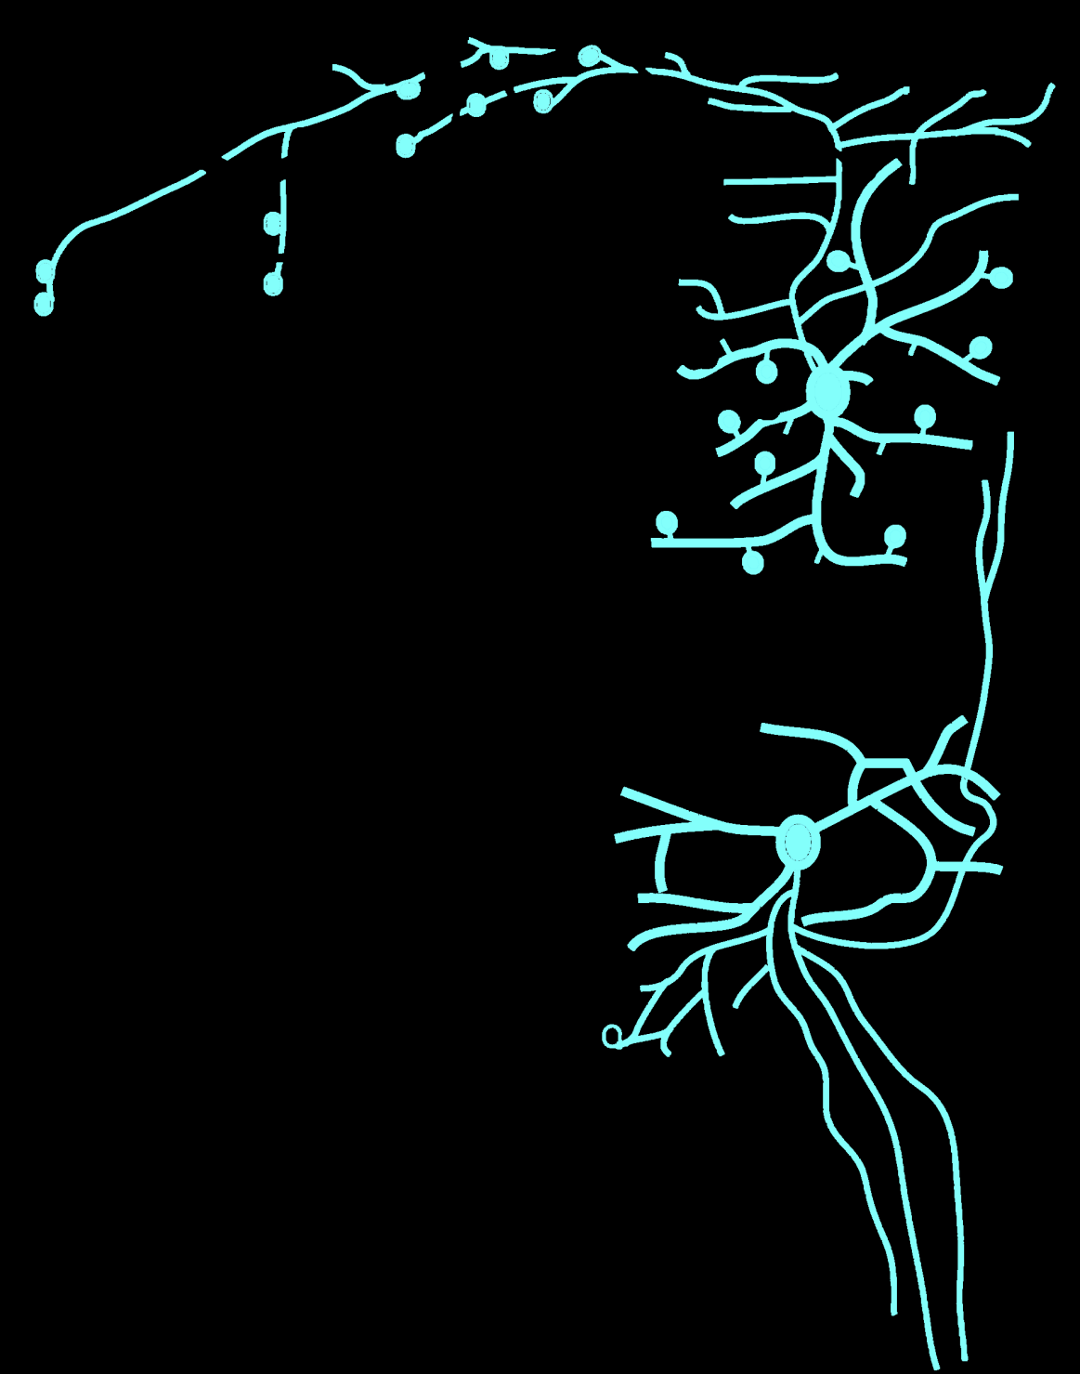
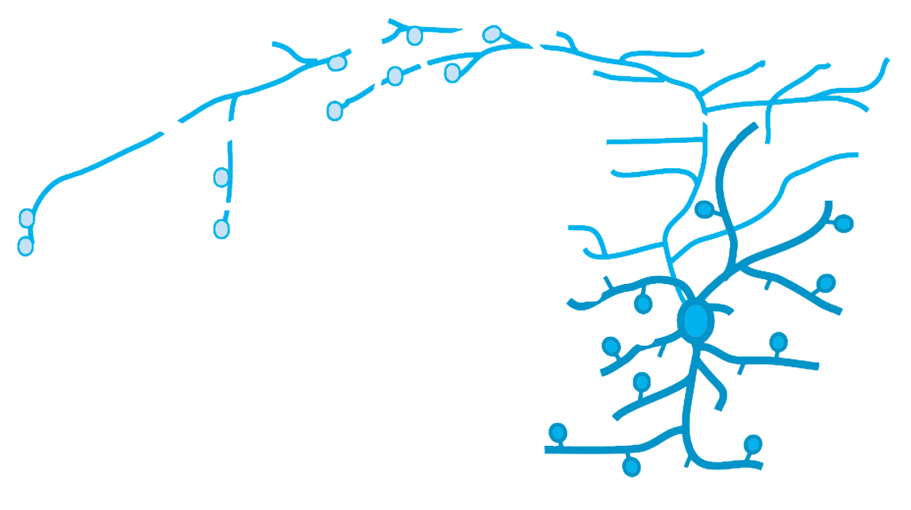
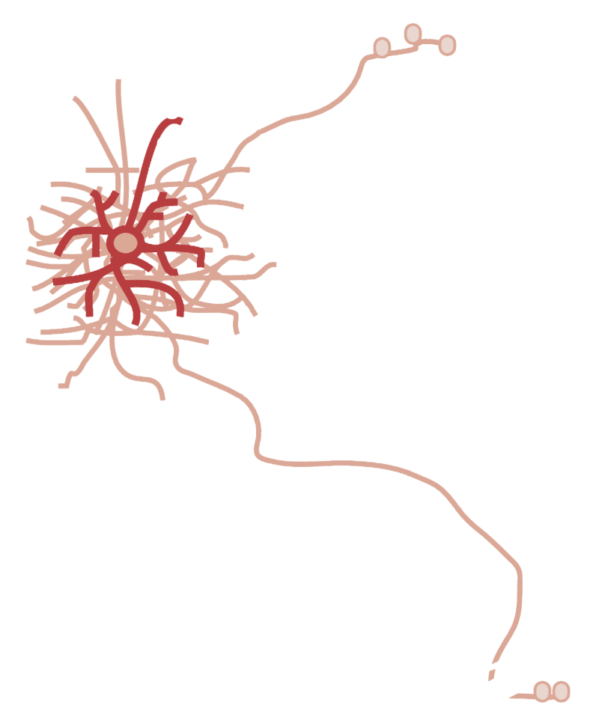
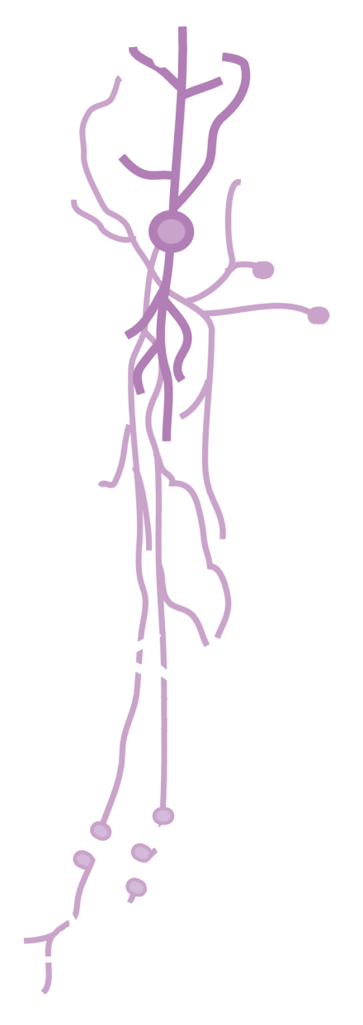

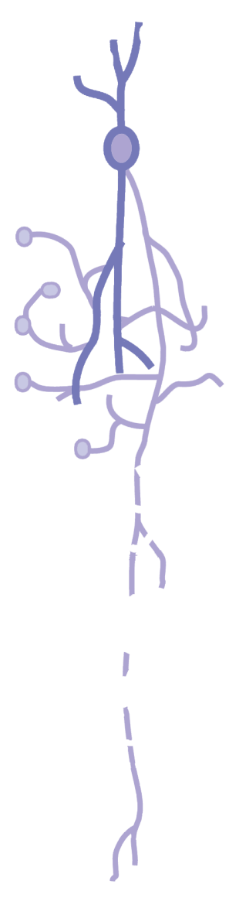
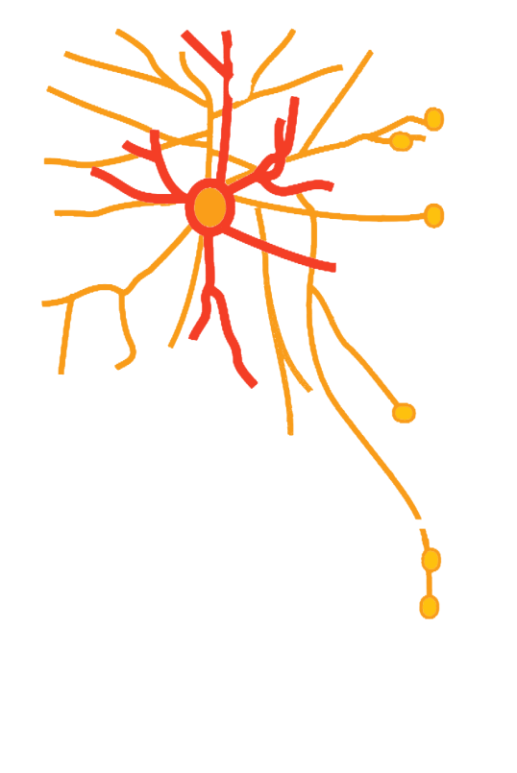
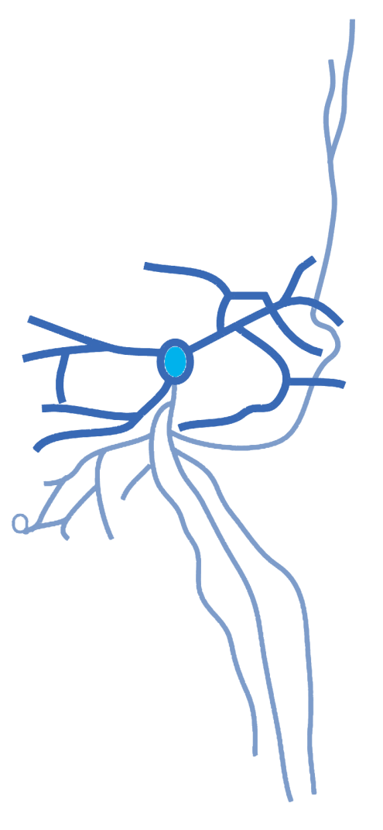
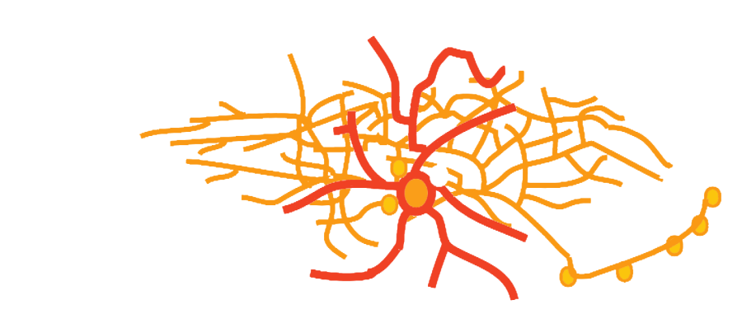
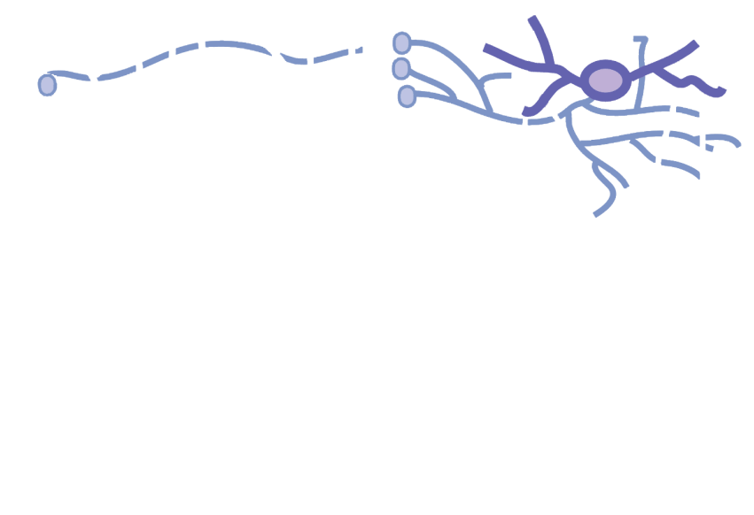
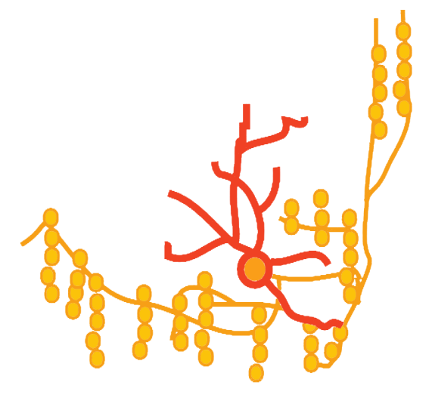
Neurogliaform, NPY
Single bouquet, CR
VIP
Double
bouquet
CR
Non-Basket
Martinotti, NPY
SS
Small
basket
VIP
PV
FS
Basket
NPY, NOS
Chandelier
SS
PV
Large basket, CCK
Figure modified from: Kubota (2014) Current Opinion in Neurobiology, 26: 7.

Slide 3
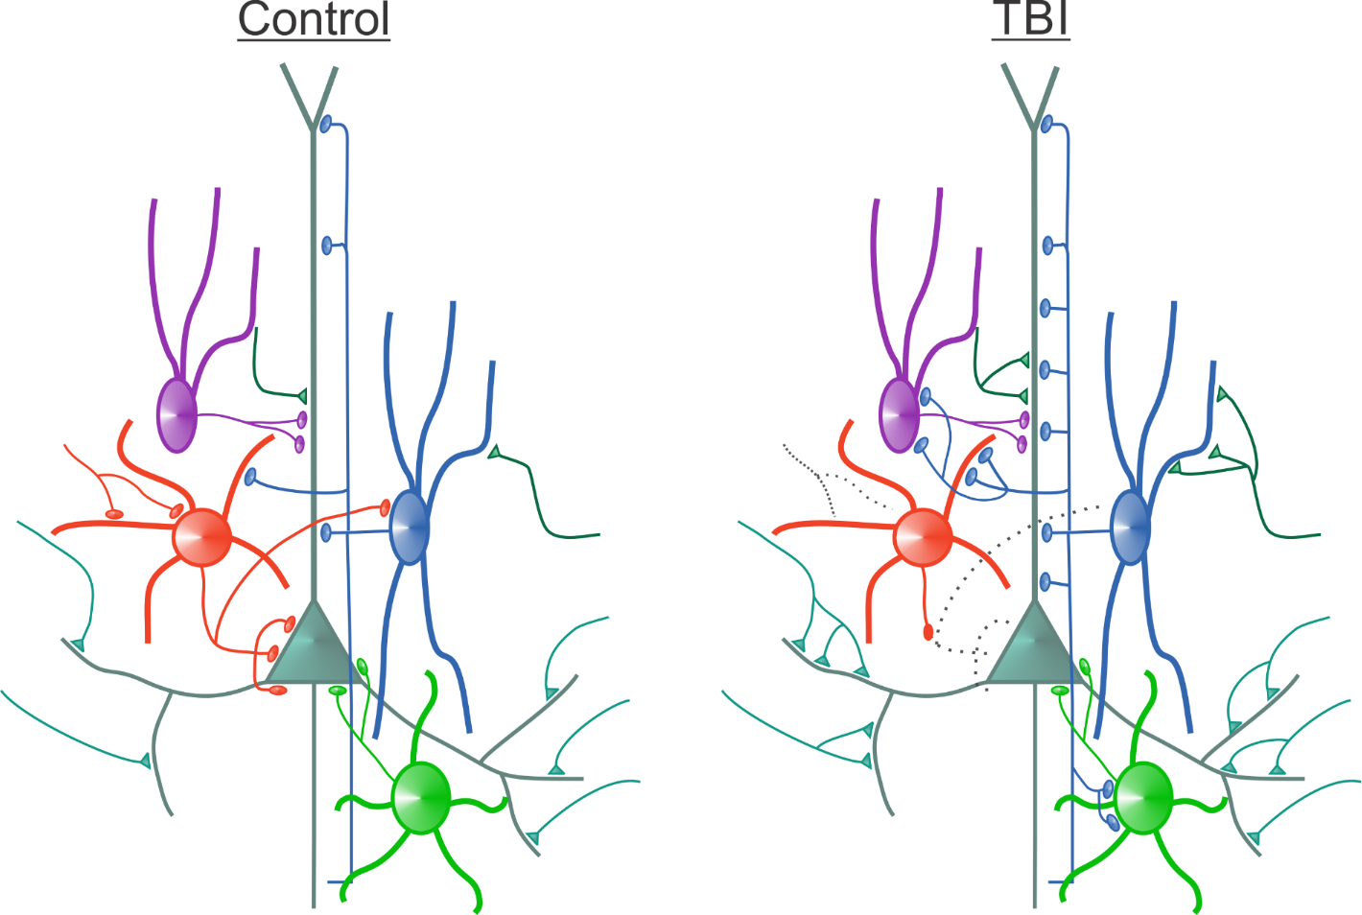
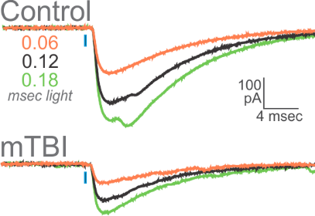
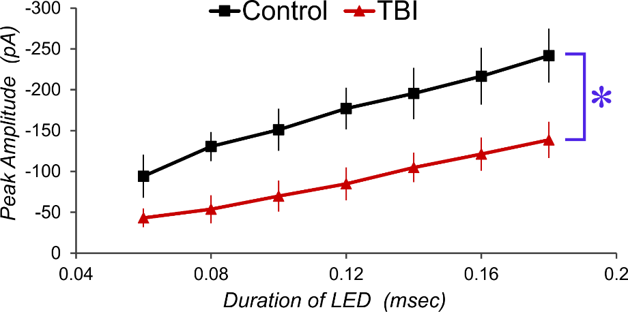
Circuitry altered by brain injury
YFP-h
Transgenic mouse
n = 5
n = 6
Postdoctoral fellow, neurosurgery resident
2 Masters students, 2 other graduate students,
~3 undergraduate students, 2 technicians

